Slide 1
Selection statements

Slide 2
Overview
Structured programming
Selection statements
If/else-if/else
Switch
Iteration
For
While
Do-while
Foreach

Slide 3

Edsger Dijkstra (1930-2002)
Algol
High level language
Goto statement considered harmful
Spaghetti code
Flow Control
The order that instructions can be executed in
Top to bottom – left to right
Structured programming

Slide 4
Structured programming
Functional decomposition
Take a large-scale problem statement and decompose it into high-level functions.
That can be decomposed into lower-level functions
Sequence
Subroutines
Selection
If/else-if/else
Iteration
while/foreach/for/do-while
Before structured programming – was extensive use of ‘goto’ statements.

Slide 5
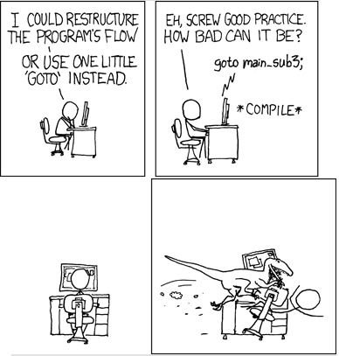
Never use Goto

Slide 6
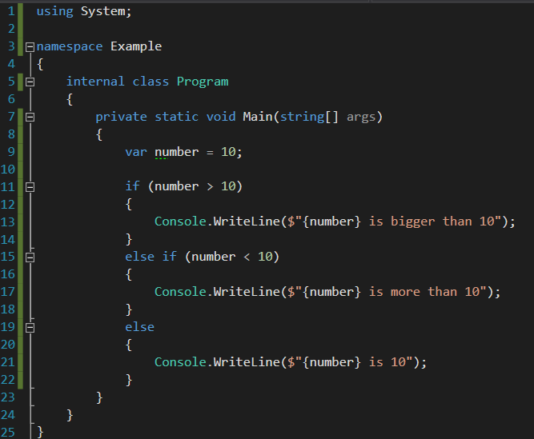
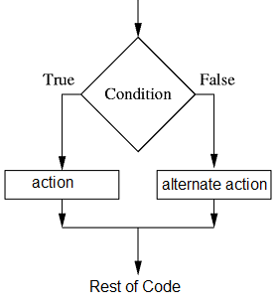
If/else-if/else

Slide 7
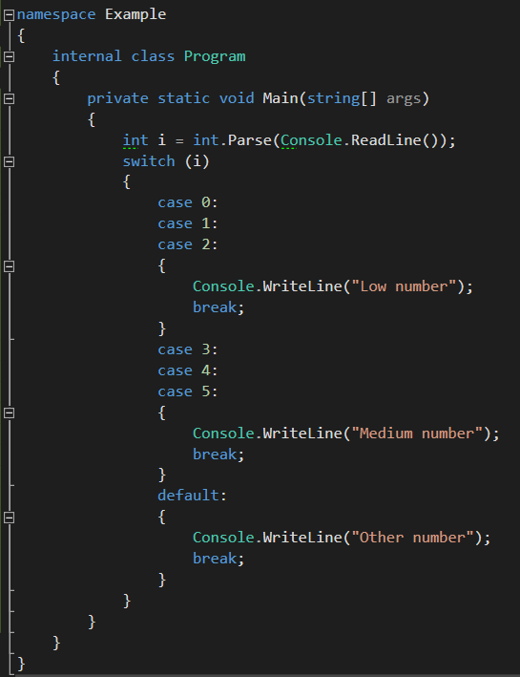
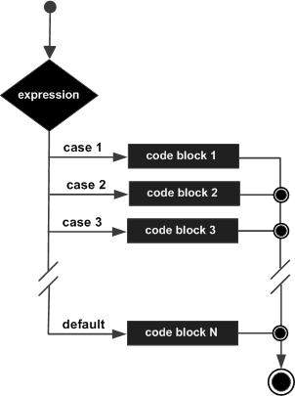
Switch

Slide 8
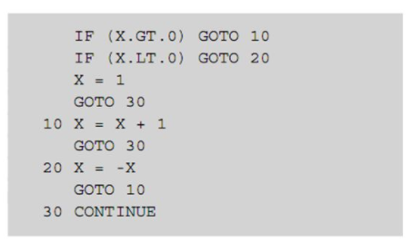
Example of GOTO statements (Fortran)

Slide 9
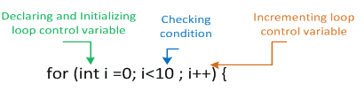
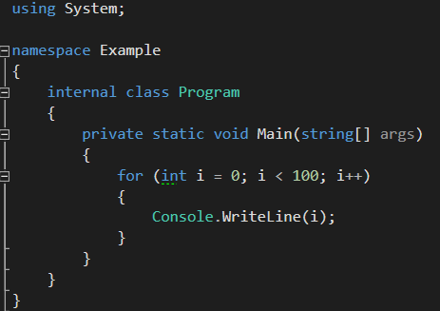
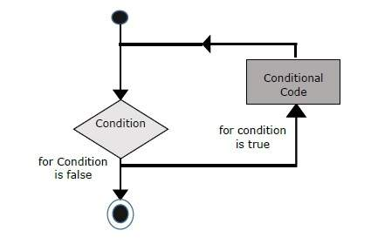
For loop

Slide 10
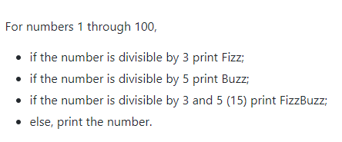
Fizz Buzz (Task)

Slide 11
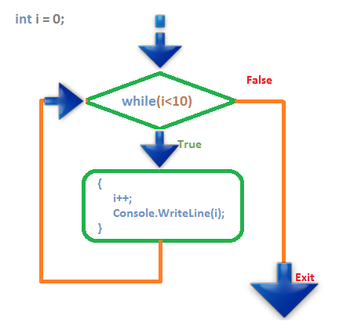
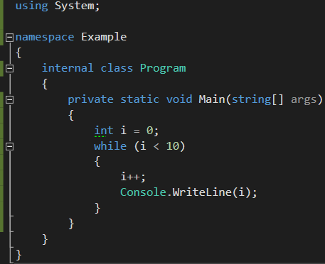
While

Slide 12
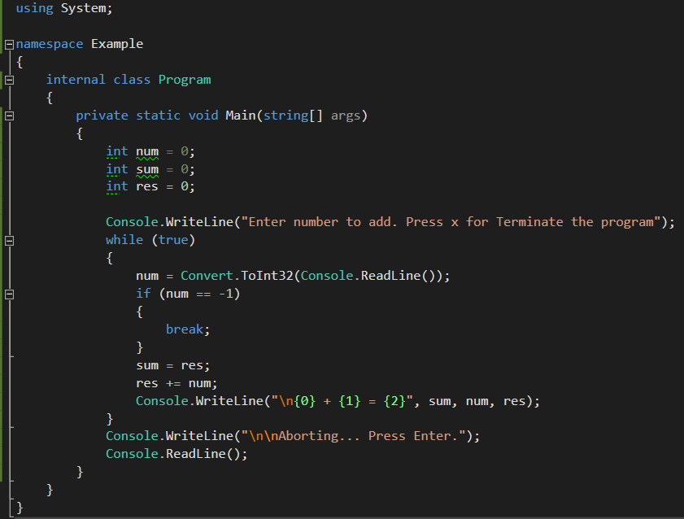
Why use a while loop?
When you want to exit on a defined condition
When you want to loop forever
When you don’t know on compile time when to exit

Slide 13
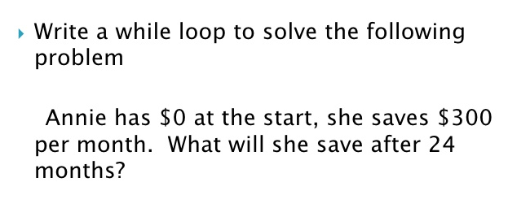
Task while loop
Use a while loop to get the following output in the console

Slide 14
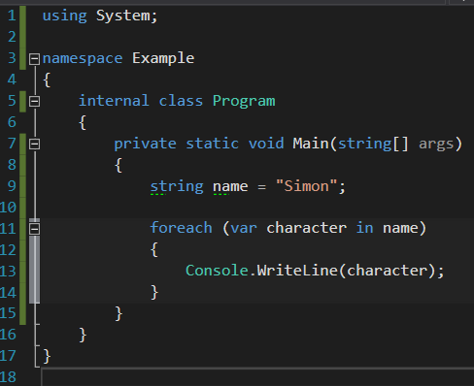
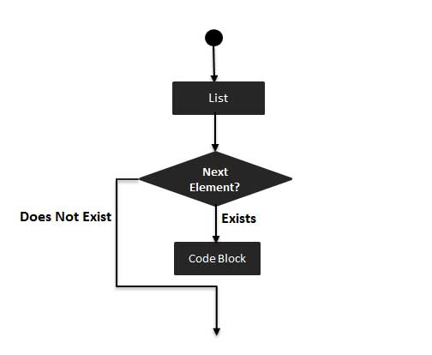
Foreach

Slide 15
Foreach (Task)
Create a program that can reverse a string, so that for example “Simon” becomes “nomiS” using a foreach loop.

Slide 16
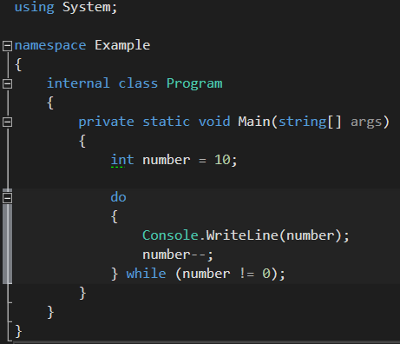
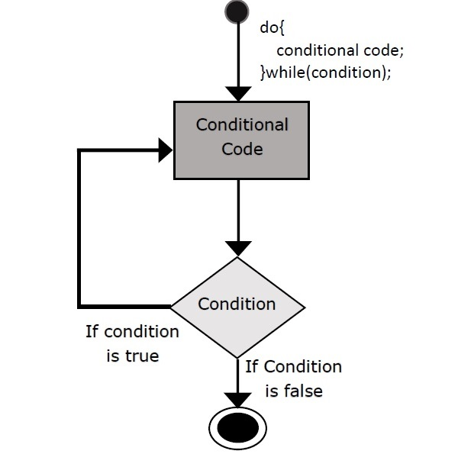
Do while

Slide 17
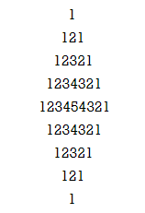
Nested loops
Use nested for loops to get the following output in the console

Slide 18
How did the day go?
Did you learn anything?
How can I improve my teaching?
Was there anything you didn’t understand?

